Slide 1


郑凯文
2018 - 9 - 14
Answering Location-Aware Graph Reachability
Queries on GeoSocial Data

Slide 2
OUTLINE
1
Introduction
2
Preliminaries
3
Our Approach
4
Initialization & Maintenance
5
Conclusion & Future Work
2/23

Slide 3
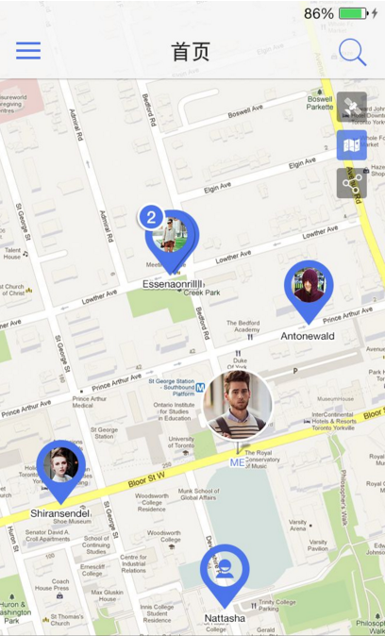
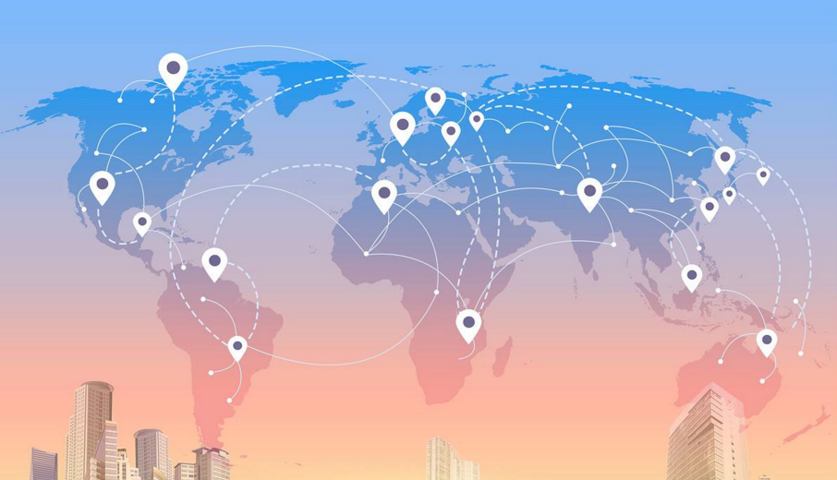
Introduction
The GeoSocial Graph
3/23

Slide 4

Introduction
P₄
P₁
P₃
Hi Siri , to find restaurants in
NewYork such that these restaurants are already visited by Mr.Du.
P₂
my friends
S₃
New York
S₁
S₄
R
S₂
RangeReach( P₁ , R )
Spatial vertex
two types of vertex: Person(P) , Restaurant(S)
An edge between two P vertices represents a friendship
An edge between a P and a S means that the Person visited the Restaurant
4/23

Slide 5
Introduction
The state-of-the-art approach:
Spatial-Reachability Indexing (abbr. SpaReach)
P₄
P₁
P₃
P₂
Uses a spatial index [1] , [2] to locate all spatial vertices V_{R} that lie within the spatial range R.
And then uses a reachability index [3], [4] to find out whether v can reach any vertex in V_{R}.
S₃
S₁
S₄
R
S₂
[1] The R*-Tree:An Efficient and Robust Access Method for Points and Rectangles.
RangeReach( P₁ , R )
[2] The Design and Analysis of Spatial Data Structures
Input:
Graph Vertex : P₁
Spatial Range : R
[3] FELINE
[4] PLL
5/23

Slide 6
Introduction
The state-of-the-art approach:
Spatial-Reachability Indexing (abbr. SpaReach)
P₄
P₁
P₃
P₂
Problem
S₃
S₁
(1)Needs to probe the reachability index for spatial vertices that may never be reached from v.
S₄
R
S₂
(2)Has to store and maintain two index structures which may preclude scalability.
RangeReach( P₁ , R )
Input:
Graph Vertex : P₁
Spatial Range : R
6/23

Slide 7
OUTLINE
1
Introduction
2
Preliminaries
3
Our Approach
4
Initialization & Maintenance
5
Conclusion & Future Work
7/23

Slide 8
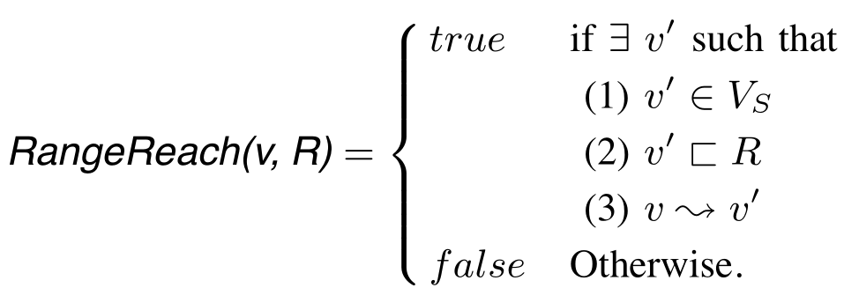
Preliminaries
P₄
P₁
P₃
P₂
S₃
S₁
S₄
R
S₂
GeoSocial Graph: directed property graph
where . may be a geometrical point, rectangle, or a polygon.
8/23

Slide 9
OUTLINE
1
Introduction
2
Preliminaries
3
Our Approach
4
Initialization & Maintenance
5
Conclusion & Future Work

Slide 10
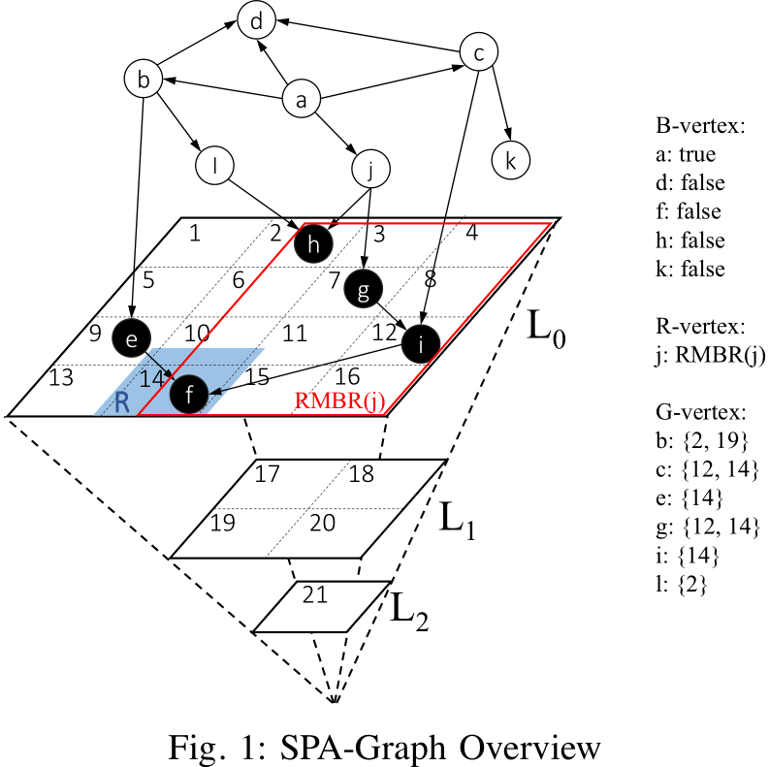
Our Approach
GEO REACH
Data Structure:
SPatially-Augmented Graph(SPA-Graph)
Augments structure with spatial indexing entries
B-Vertex: stores whether v can reach any Vs
R-Vertex: stores a Reachability Minimum Bounding Rectangle
(RMBR) top-left lower-right
G-Vertex: stores a list of spatial grid cells
10/23

Slide 11
Our Approach
GEO REACH
Query Processing:
RangeReach( v , R )
TRUE
RangeReach( a , R )
Case I (B-vertex): False then stop, else further traversal
Case II (R-vertex):Three cases
a.RMBR(v) lies within R
b.All reachable spatial vertices of v is outside R
c.RMBR(v) is partially covered by R
Case III (G-vertex):
It's same like Case II
11/23

Slide 12
OUTLINE
1
Introduction
2
Preliminaries
3
Our Approach
4
Initialization & Maintenance
5
Conclusion & Future Work

Slide 13
Initialization & Maintenance
MAX_RMBR: If area of RMBR(v) is larger than it .
v: R-vertex to B-vertex.
(0.8A)
MAX_REACH_GRIDS:
If the number of grid cells in ReachGrid(v) exceed it.
v: G-vertex to R-vertex.
(MAX_REACH_GRIDS = 3)
13/23

Slide 14
Initialization & Maintenance
(1) follows the topological order
accumulate reachability information
(2) follows the rule of parameter
initial type of v by checking
exact types of out-neighbors of v
14/23

Slide 15
Initialization & Maintenance
Example:
MAX_RMBR = 0.8A
MAX_REACH_GRIDS = 3
one correct topological is
ReachGrid(v) is updated by adding in ReachGrid(v') and Grid(v')
v' ∈ v_{out}
ReachGrid(i) =ReachGrid(f ) ∪ Grid(f) = ∅∪ {14} = {14}
ReachGrid(g) =ReachGrid(i) ∪ Grid(i) = {14}∪ {12} = {12,14}
15/23

Slide 16
Initialization & Maintenance
Example:
MAX_RMBR = 0.8A
MAX_REACH_GRIDS = 3
one correct topological is
ReachGrid(b) =ReachGrid(l) ∪ReachGrid(e) ∪Grid(e) = {2}∪{14}∪{9} = {2,9,14}
ReachGrid(j) = {2,7,12,14}
MAX_REACH_GRIDS = 3
v: G-vertex to R-vertex.
MAX_RMBR = 0.8A
j:RMBR(j)
16/23

Slide 17
Initialization & Maintenance
Example:
MAX_RMBR = 0.8A
MAX_REACH_GRIDS = 3
one correct topological is
ReachGrid(a) = {2,7,9,12,14}
MAX_REACH_GRIDS = 3
a: G-vertex to R-vertex.
MAX_RMBR = 0.8A
a:RMBR(a) > 0.8A
a: R-vertex to B-vertex.
a:true
17/23

Slide 18
OUTLINE
1
Introduction
2
Preliminaries
3
Our Approach
4
Initialization & Maintenance
5
Conclusion & Future Work

Slide 19
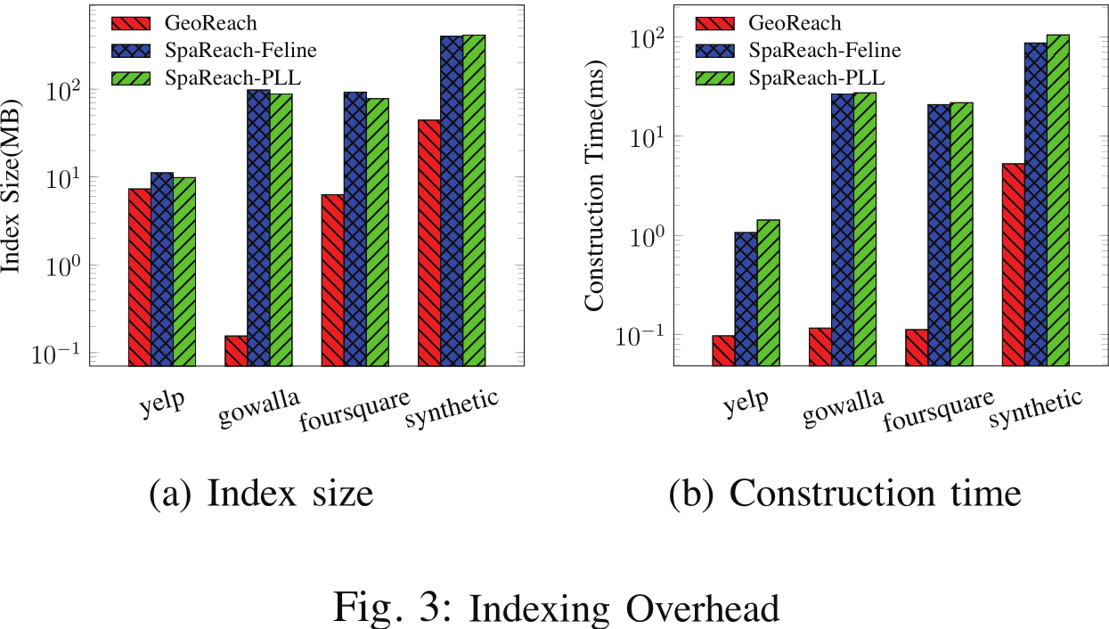
Conclusion & Future Work
19/23

Slide 20
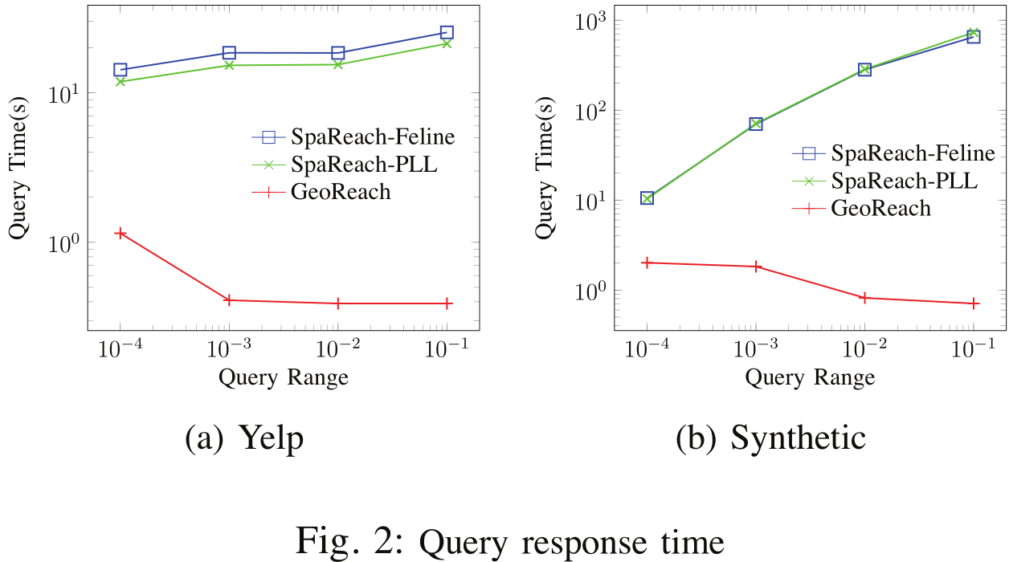
Conclusion & Future Work
Input query rectangle varies from 0.0001 to 0.1
Run 500 random queries
20/23

Slide 21
Conclusion & Future Work
The paper motivates location-aware reachability queries RangeReach( v , R ) over a GeoSocial graph.
A novel approach GEO REACH is proposed to efficiently answers the query.
21/23

Slide 22
Conclusion & Future Work
In the future, we plan to study the extensibility of
GEO REACH to support different spatial predicates (e.g., spatial join).
Spatial Influence Maximization,
Location and Social-Aware Recommendation,
Location-Aware Citation Network Analysis.
22/23

Slide 23
Thank You!

